Slide 1
CAPSTONE PROJECT
E-Commerese Website Logs
Presented By:
1. NAME: SAKTHI.S.S
2. DEPT: CIVIL ENGINEERING
3.COLLEGE : Thanthai Periyar Govt. Institude of Technology

Slide 2
OUTLINE
Problem Statement
Proposed System/Solution
System Development Approach
Algorithm & Deployment
Result
Conclusion
Future Scope
References

Slide 3
PROBLEM STATEMENT
An explanation of the dataset's significance
Analyzing unstructured e-commerce website logs presents
difficulties
To extract meaningful insights, exploratory data analysis and
visualization are required.

Slide 4
PROPOSED SOLUTION
Overview of the suggested remedy:
Making use of exploratory data analysis (EDA) methods
Using data visualization to enhance comprehension
The significance of comprehending consumer behavior and
refining sales tactics

Slide 5
SYSTEM APPROACH
Synopsis of the approach to system development:
Gathering and preparing data
Analyzing exploratory data
Techniques for visualizing data
Interpretation and the creation of insights

Slide 6
ALGORITHM & DEPLOYMENT
Algorithms (if any) employed in data analysis
Methodology for deploying the analysis:
Technologies and tools used for on-premises installation
or cloud-based deployment

Slide 7
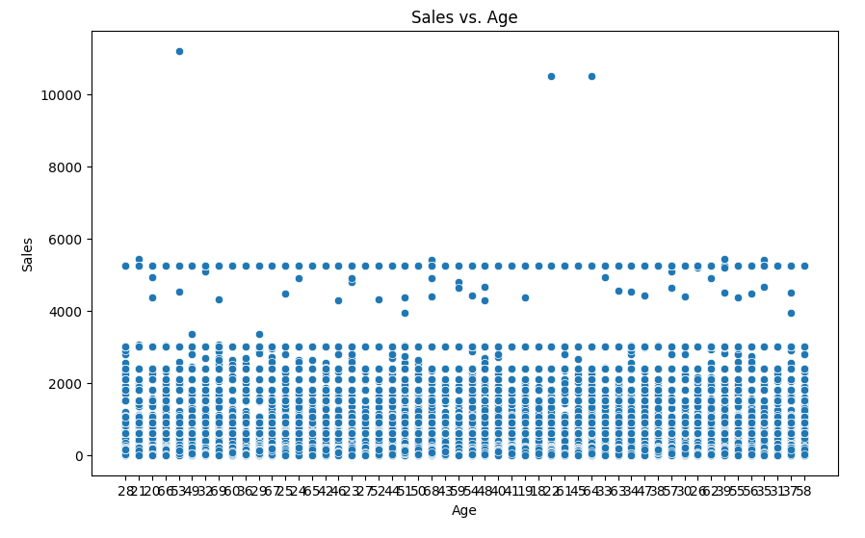
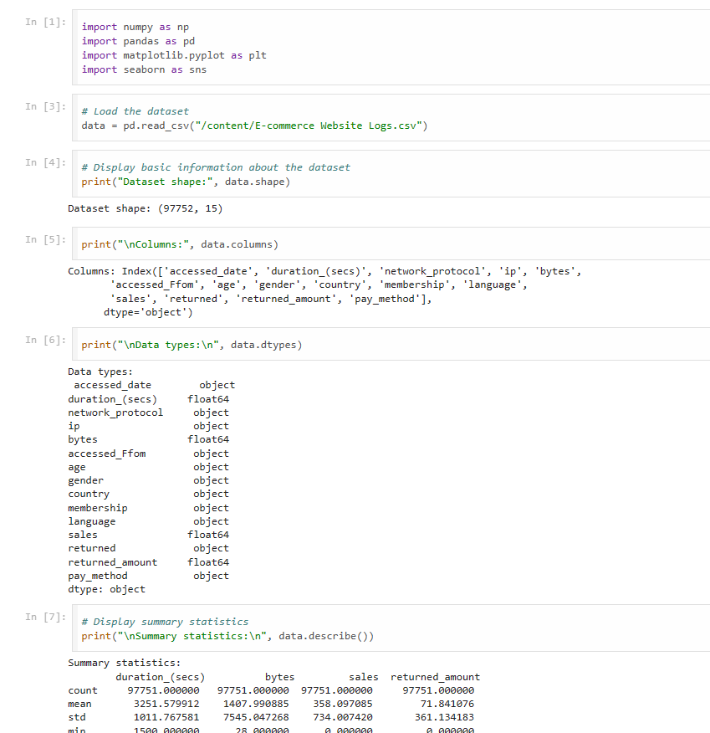
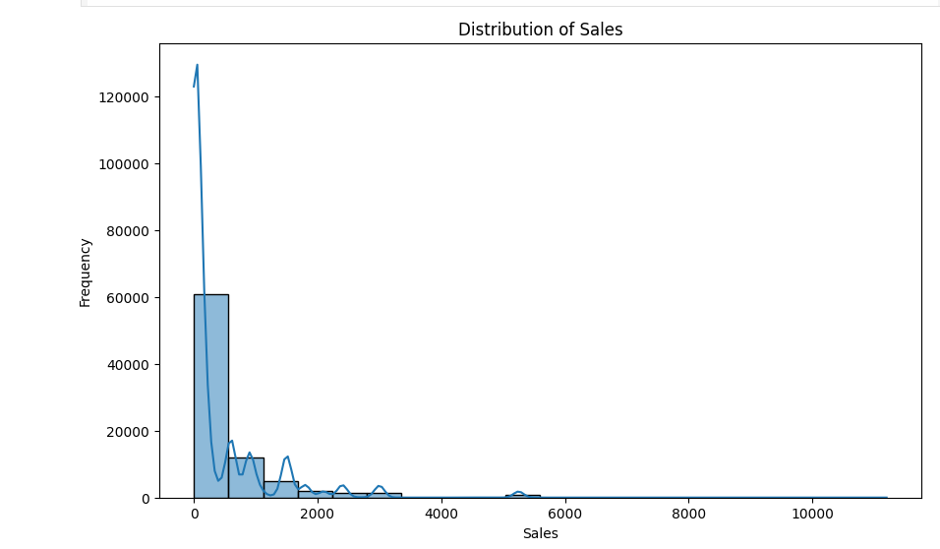
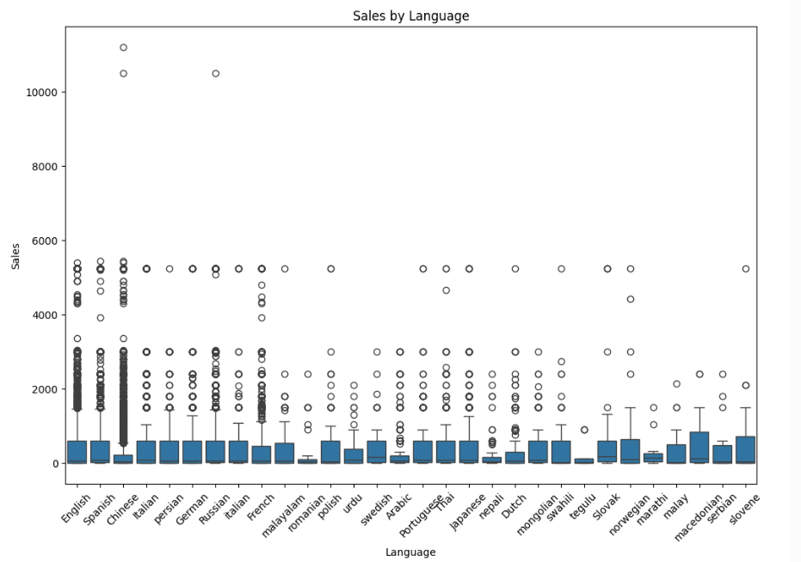
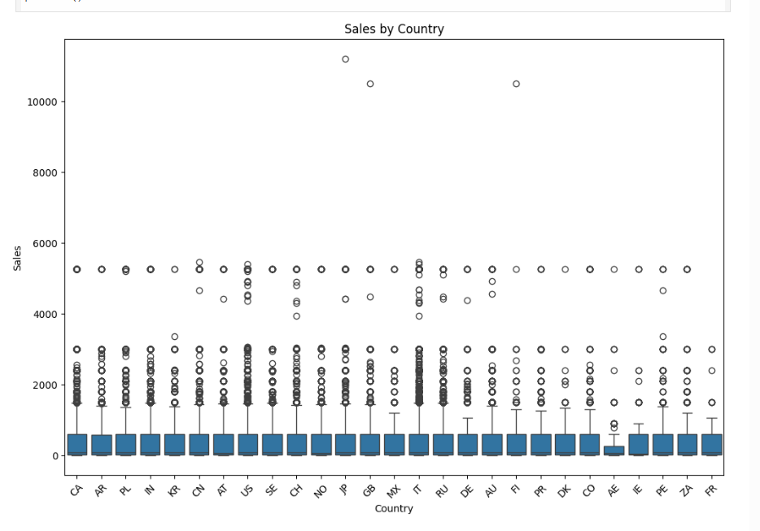
RESULT

Slide 8
CONCLUSION
A synopsis of the main conclusions and observations
The role that data visualization and EDA play in informing
business decisions
consequences for marketing campaigns and e-commerce
strategies

Slide 9
FUTURE SCOPE
Possibilities for more research and development:
sophisticated machine learning methods for forecasting
tracking and analyzing website records in real time
Integration with additional data sources to provide a holistic
perspective

Slide 10
REFERENCES
List of references and sources used in the development of the analysis and presentation
Add scholarly publications, papers, and web resources.

Slide 11
THANK YOU

